Slide 1
WEB CHAT APPLICATION
Presented by:- Ashish Tiwari
Vishal Mishra
Ankit Singh Chauhan
Anshika Gaur
Anuradha Kumari

Slide 2
Contents
Introduction
Module and description
Hardware and Software specification
Front End and Back End
DFD
Screen Shot
Conclusion
Future Reference

Slide 3
Introduction
A web chat application enables real-time text communication between users, featuring instant messaging, user authentication, group chats, and media sharing. Built with web technologies, it’s commonly used for customer support, social networking, and team collaboration.

Slide 4
Modules
User Authentication – Verifies and registers users securely.
Chat Interface – Provides a user-friendly interface for messaging.
Real-Time Messaging – Enables instant sending and receiving of messages.
Group Chat – Allows multiple users to join a common chat room.
Media Sharing – Lets users share images, files, and other media.
Notifications – Alerts users of new messages or activities.
Message History – Stores chat history for users to review past conversations.
Admin Control – Manages user access, permissions, and content moderation.

Slide 5
Hardware Specification
Processor: Multi-core CPU
RAM: 8GB
Storage: SSD (solid-state drive) for faster data access.
Device: Desktop, laptop, tablet, or smartphone
Browser: Modern web browser (e.g., Chrome, Firefox, Safari)
Internet: Stable connection (Wi-Fi or mobile data)

Slide 6
Software Requirement
Frontend Technologies:
HTML, CSS, JavaScript
Frameworks: React.js
Backend Technologies:
Server: Node.js
WebSocket or Socket.IO for real-time messaging
Database:
SQL (e.g., MySQL) for storing user data and messages.

Slide 7
Front End
HTML
CSS
JavaScript
React Js

Slide 8
Back End
Node Js
MangoDB

Slide 9
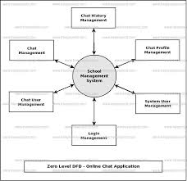
DFD (Data Flow Diagram)

Slide 10
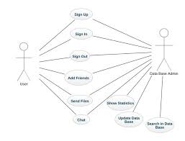
Use Case Applicaton

Slide 11
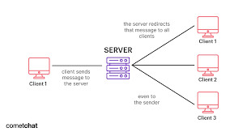
Chat Appliction (ScreenShot)

Slide 12
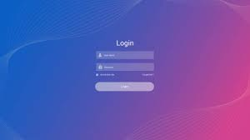
Login Page
Enter the valid user id and password then click on submit button.
If user is not registered then click on create new account.
If user forget password then click on forget password button.

Slide 13
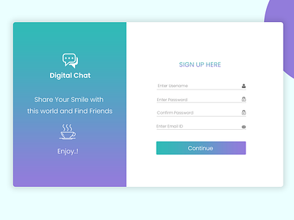
Sign Up Page
Here user enter all the details according to the registration page.
User must be enter the valid email ID.

Slide 14
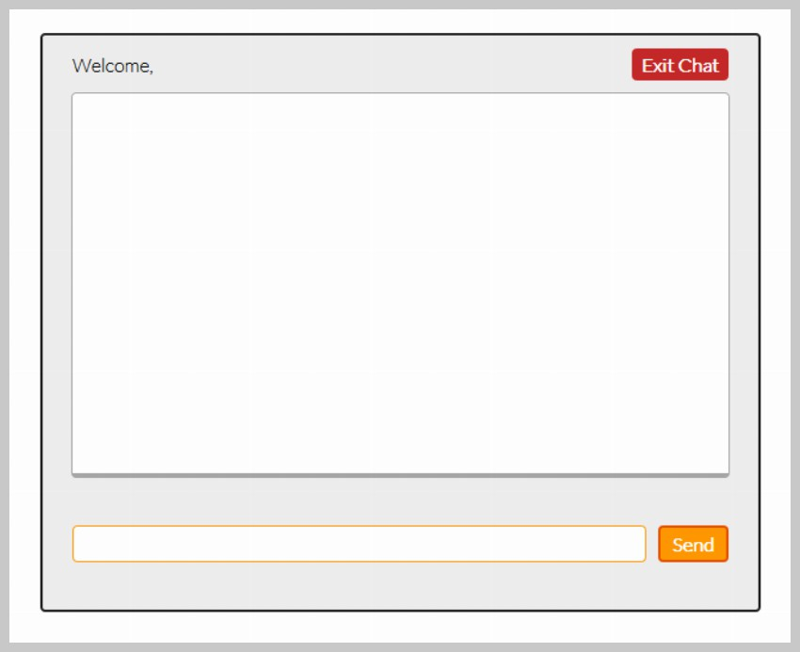
User’s Home Page

Slide 15
Conclusion
Real-Time Communication – Enables instant messaging for seamless user interaction.
User-Friendly Interface – Provides an intuitive, responsive design across devices.
Security – Ensures data protection with authentication and encryption.
Scalability – Designed to handle increased user loads and new features.
Versatile Application – Suitable for customer support, social interaction, and team collaboration.
Summary:
The web chat app delivers secure, real-time communication with a user-friendly interface, scalability, and versatility for various uses.

Slide 16
THANK YOU

